Slide 1

Domain-Driven Design (DDD)

Slide 2

Agenda
Introducing DDD
Modeling Problems in Software
Elements of a Domain Model
Understanding Value Objects & Services in the Model
Talking Complexity with Aggregates
Working with Repositories
Domain Events and Anti-corruption Layers
resources

Slide 3
1
Introducing DDD

Slide 4
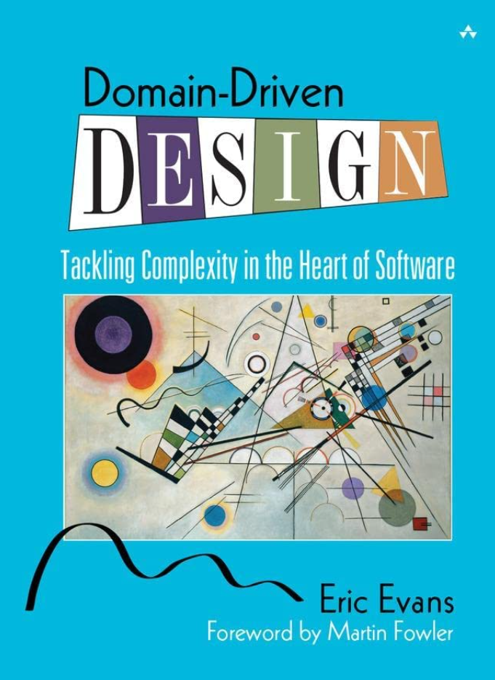
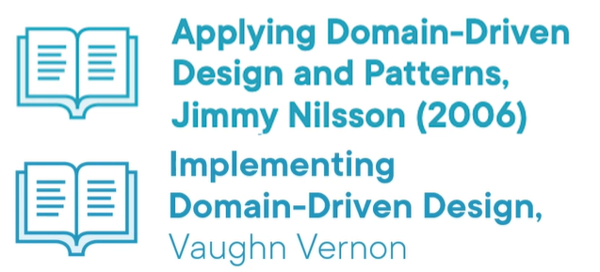
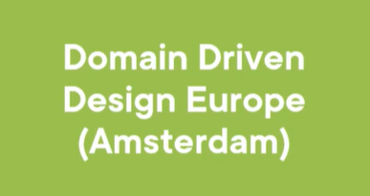
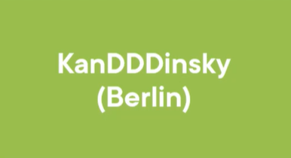
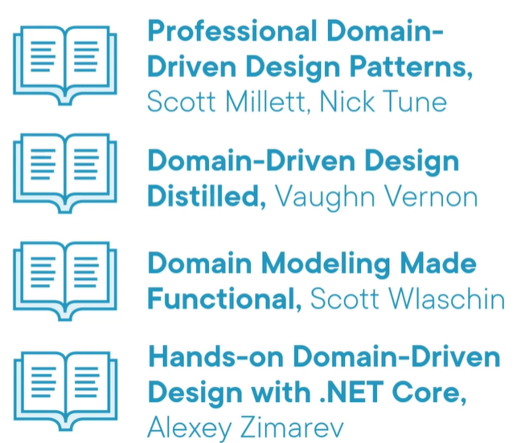
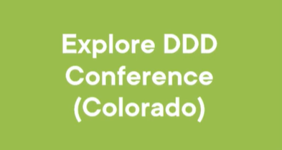
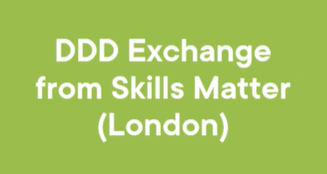
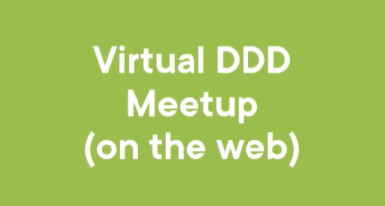
DDD History
Beginnings
Eric Evans 2003
Now
Many new DDD books Many conferences

Slide 5
What is DDD?
Domain-Driven Design is an approach to software development that centers the development on programming a domain model that has rich understanding of the processes and rules of a domain.

Slide 6
DDD Core Themes
Interaction with domain experts
Model a single subdomain at a time
Implementation of subdomains

Slide 7
DDD is Complex
DDD is a really complex topic, this is just an introduction.
Also, DDD is for solving COMPLEX problems.
DDD isn't suitable for problems when there is little business domain complexity.

Slide 8
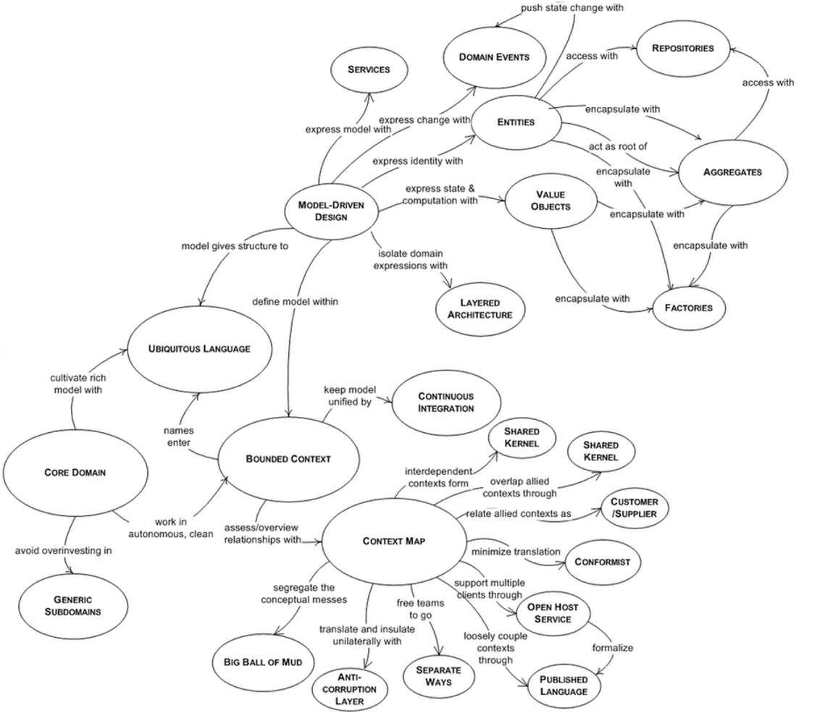
DDD Mind Map

Slide 9
DDD Prerequisites
Development is iterative. (the agile development methods are good fit.)
Developers and domain experts have a close relationship. (will be explained later)

Slide 10
2
Modeling Problems in Software

Slide 11
Domain Expert
These are the people who live and breed the business or process or whatever you are targeting with the software you're planning to write.
Invest in your relationship with the domain expert.
Important to get on the "same page" with the domain expert.
Learn and communicate in the language of domain, not the language of technology.

Slide 12
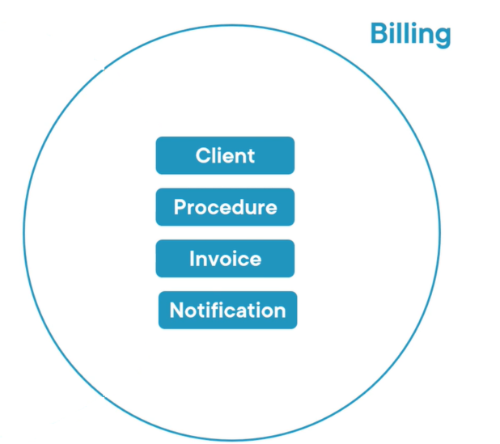
Bounded Context
A bounded context is simply the boundary within a domain where a particular domain model applies.

Slide 13
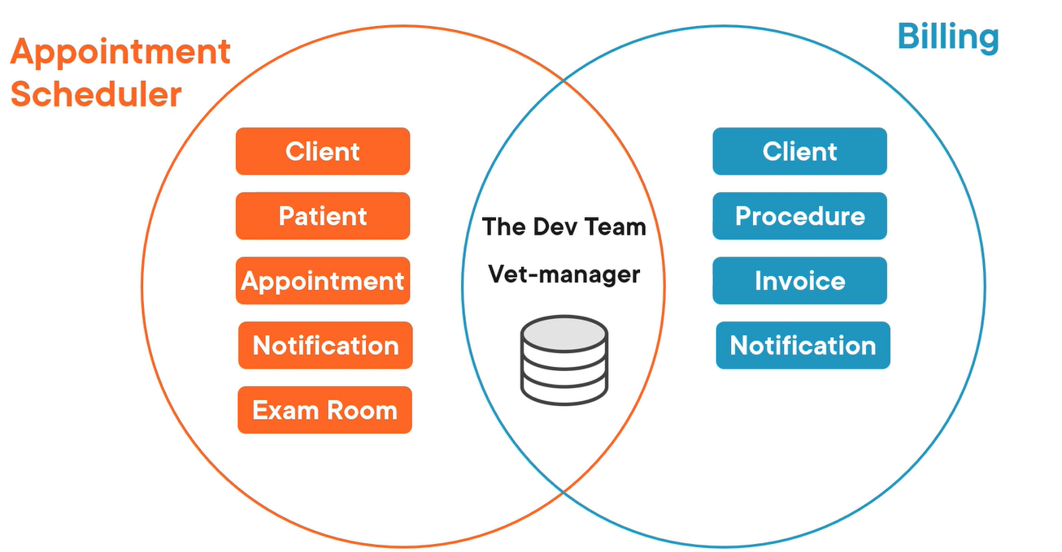
Context Map
Demonstrates how bounded contexts connect to one another while supporting communication between teams.

Slide 14
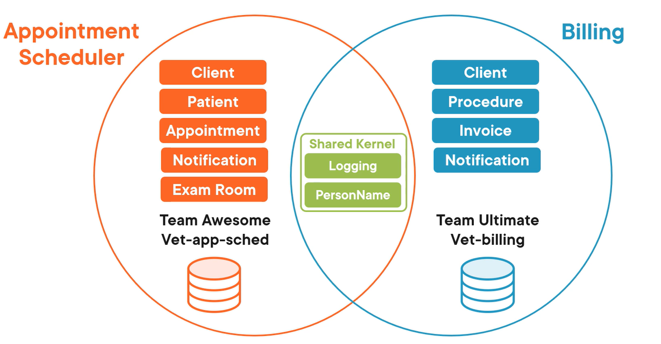
Shared Kernel
Bounded contexts have shared concepts or resources - this is called shared kernel.
The goal is to reduce duplication.

Slide 15
Ubiquitous Language
A simple definition of a ubiquitous language is to come up with terms that'll be commonly used when discussing a particular subdomain.
And they will most likely be terms that come from the PROBLEM SPACE, NOT THE SOFTWARE WORLD!

Slide 16
3
Elements of a Domain Model

Slide 17
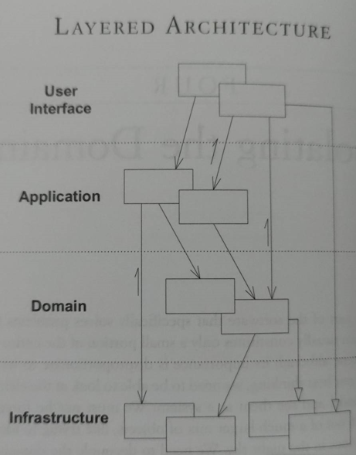
Domain Layer
The domain is the hart of business software.
The Domain Layer is responsible for representing concepts of the business, information about the business situation, and business rules.
We're isolating the domain using layered architecture.

Slide 18
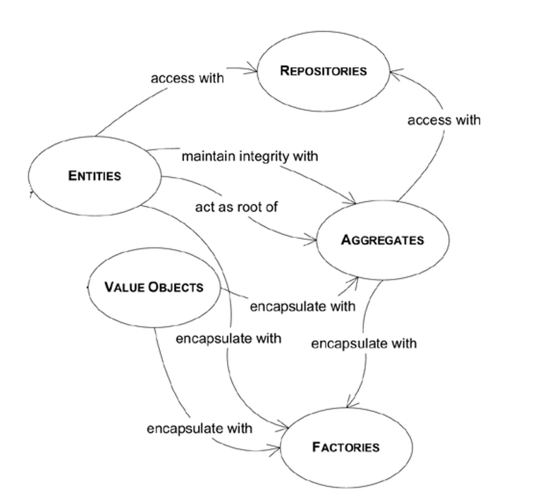
Elements of Domain model

Slide 19
Entity
An entity is something we need to be able to track, locate, retrieve, and store, and we do that with an identity key.
Entity is a mutable class with an identity.

Slide 20
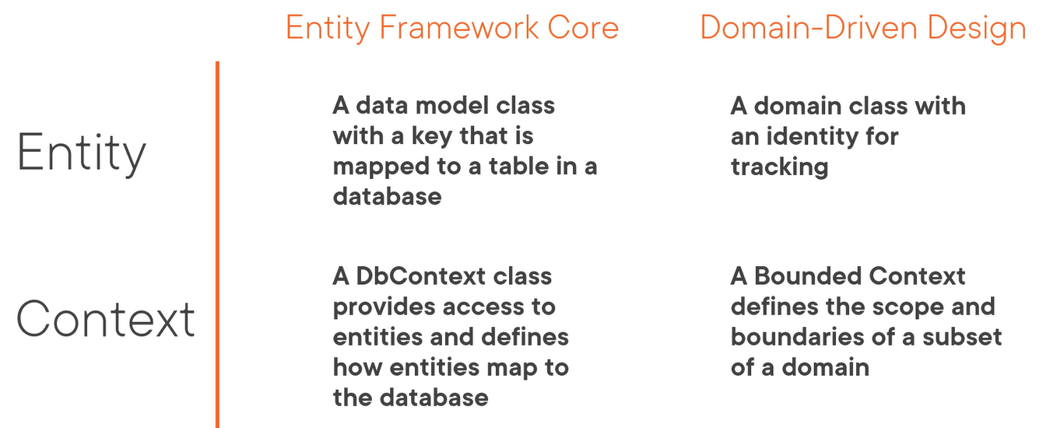
DDD Terms
Some of the issues are that the DDD terms overlap with technology terms. Most of the terms are really different.

Slide 21
4
Understanding Value Objects & Services in the Model

Slide 22
Value Object
An object that represents a descriptive aspect of the domain with no conceptual identity is called a VALUE OBJECT.
Value objects: - Measures, quantifies, or describes a thing in the domain - Identity is based on composition of values - Immutable - Compared using all values - No side effect
Examples: string, datetime, money

Slide 23
Domain Service
Provide a place in the model to hold behavior that doesn't belong elsewhere in that domain.
A service is often appropriate for operation that doesn't belong in entity or value object.

Slide 24
4
Talking Complexity with Aggregates

Slide 25
Aggregates
An aggregate is a cluster of associated objects (Entities and Value Objects) that we treat as a unit for the purpose of data changes.
Any object internal to an aggregate is prohibited from access except by traversal from the root.

Slide 26
Aggregate Root
Every aggregate has a root, the root should be an entity.
Choose one entity to be the root of each aggregate, and control all access to the objects inside the boundary through the root.

Slide 27
4
Working with Repositories

Slide 28
Repository
An abstraction the domain model uses to define what persistence needs it has.
General repository tips 1. Use repositories for aggregate roots only. 2. Keep the clients focused on model, while delegating all of the object storage and access concerns to the repositories.

Slide 29
Specification
Specification is a method of encapsulating a business rule so that it can be passed to other methods which are responsible for applying it.

Slide 30
4
Domain Events and Anti-corruption Layers

Slide 31
Domain Events
Domain events alert that some activity occurred, or some state changed in the context and their domains can subscribe to the "news".
Domain events features: - Can communicate outside of the domain - Encapsulated as objects - Each event is full-fledged class

Slide 32
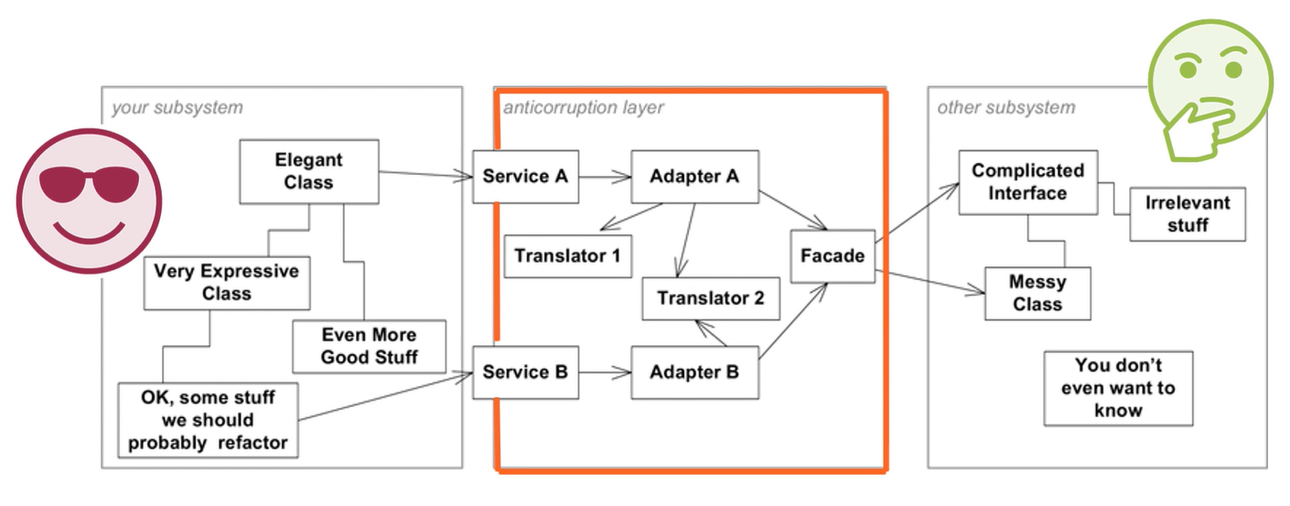
Anti-corruption layer
Anti-corruption layers helps to prevent corruption in the domain model.
This layer translates the communication between layers, with this we're stopping corruption in our models.

Slide 33
6
Resources

Slide 34
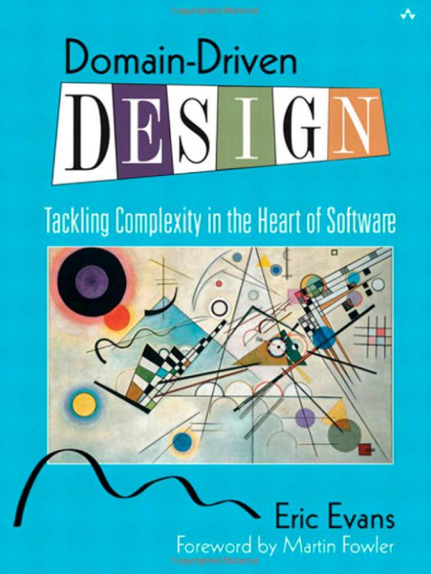
Domain-Driven Design: Tackling Complexity in the Heart of Software

Slide 35
Other resources
As mentioned in the beginning there are many newer books about DDD.
Courses: Domain-Driven Design Fundamentals (new version, 2021) https://app.pluralsight.com/library/courses/fundamentals-domain-driven-design/table-of-contents Domain-Driven Design Fundamentals (old version, from the same authors, 2014) https://app.pluralsight.com/library/courses/domain-driven-design-fundamentals/table-of-contents Domain-Driven Design in Practice https://app.pluralsight.com/library/courses/domain-driven-design-in-practice/table-of-contents Domain-Driven Design: Working with Legacy Projects https://app.pluralsight.com/library/courses/domain-driven-design-legacy-projects/table-of-contents Domain-Driven Design Path https://app.pluralsight.com/paths/skill/domain-driven-design
Code repo: https://github.com/ardalis/pluralsight-ddd-fundamentals Links: https://www.dddcommunity.org https://www.domainlanguage.com

Slide 36


